Slide 1
Grading Strategies Fall 2025
Pamela Hardin, PhD
Associate Director
Martha Bradley Evans Center for Teaching Excellence

Slide 2
At the end of this session, you will be able to
Describe how structuring assignments assists with grading
Describe different methods in Canvas to automate grading
Describe different methods in Canvas to combine automated and personalized feedback
Identify uses for Grade Scope in higher education as a tool to assist with automated and personalized grading
For fully online courses (090), understand use of Proctored Exams, and who to contact to help set up exams.

Slide 3
In the Chat: Write what your most challenging issue/s is with grading: Feel free to embellish with emoji illustrating your feelings about grading

Slide 4
Assignment Instructions 1) Purpose (skills and knowledge) 2) Task – steps needed to complete the assignment 3) Criteria for success – what students need to do, and submit, to be successful on the assignment Example from Canvas Course (setting up transparent assignment)
Transparency in Teaching (and grading)
Create Structured Assignments

Slide 5
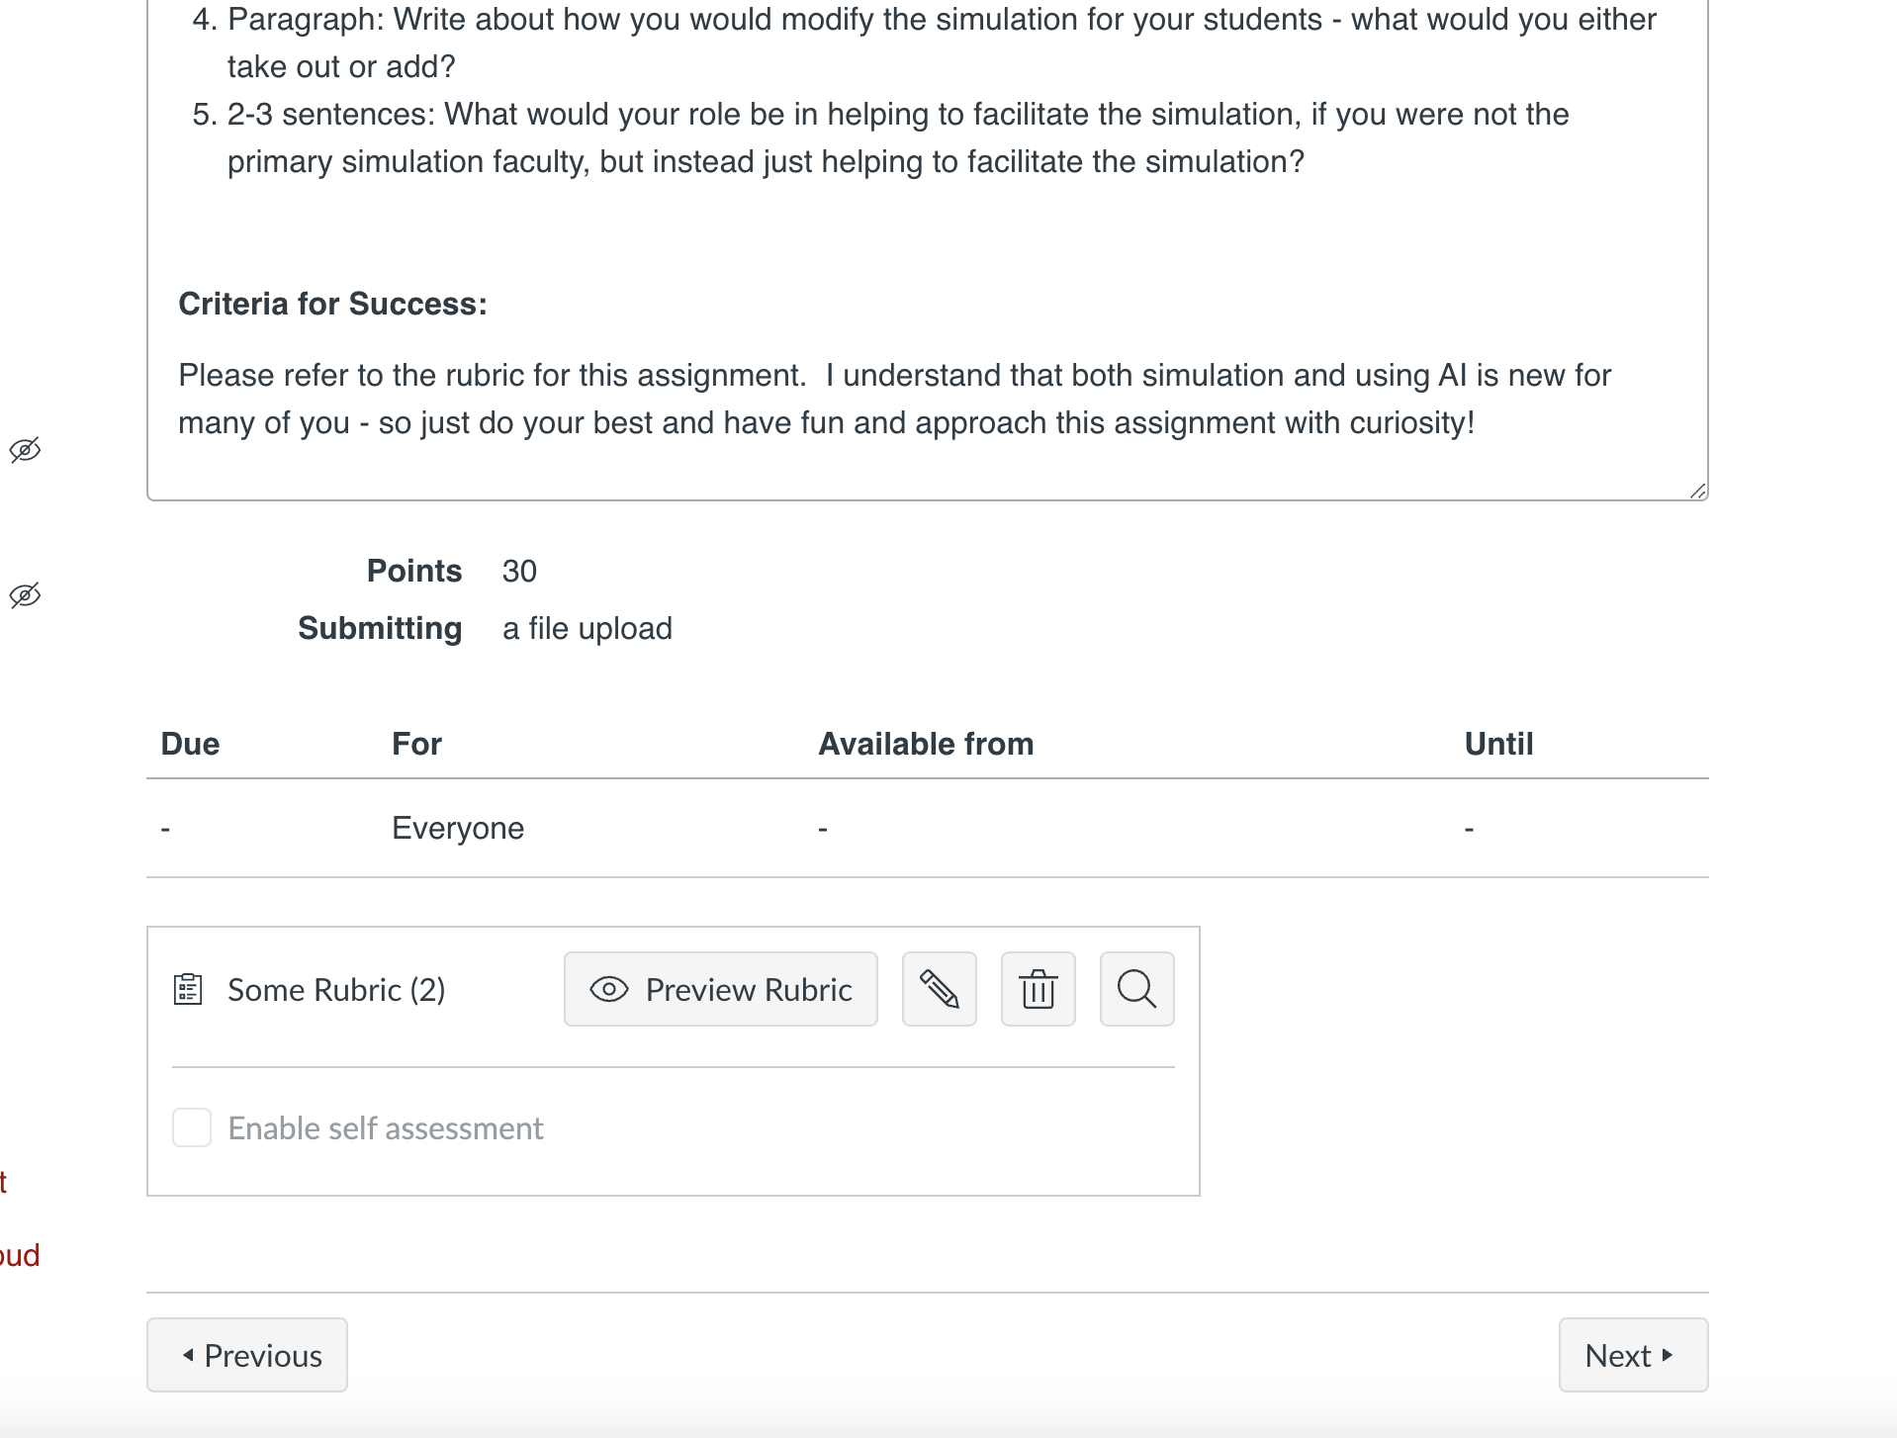
Canvas Rubric

Slide 6
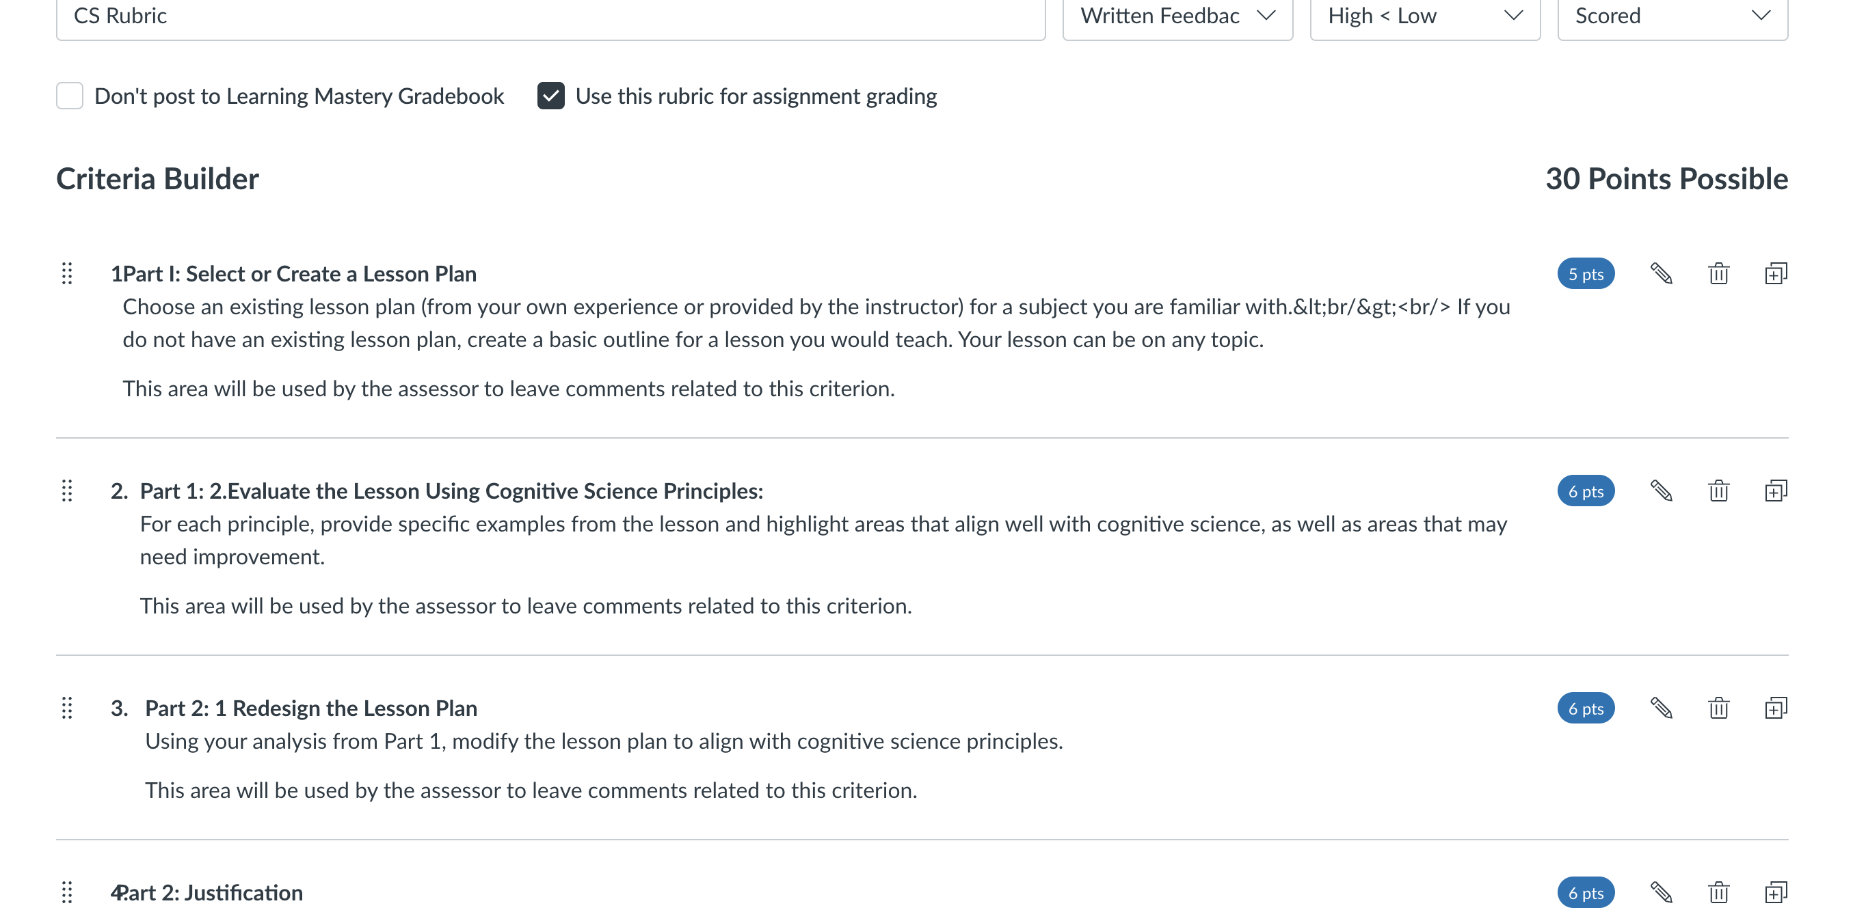
Using Canvas Rubrics and Speedgrader

Slide 7
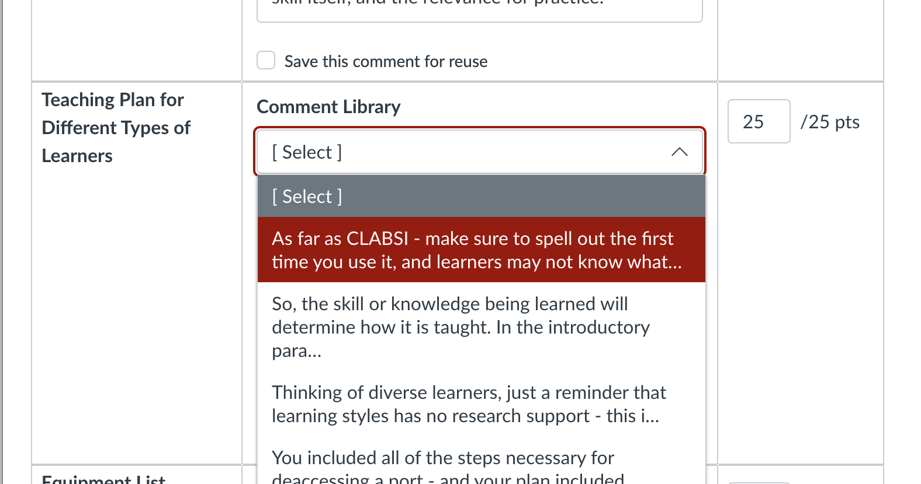

Slide 8
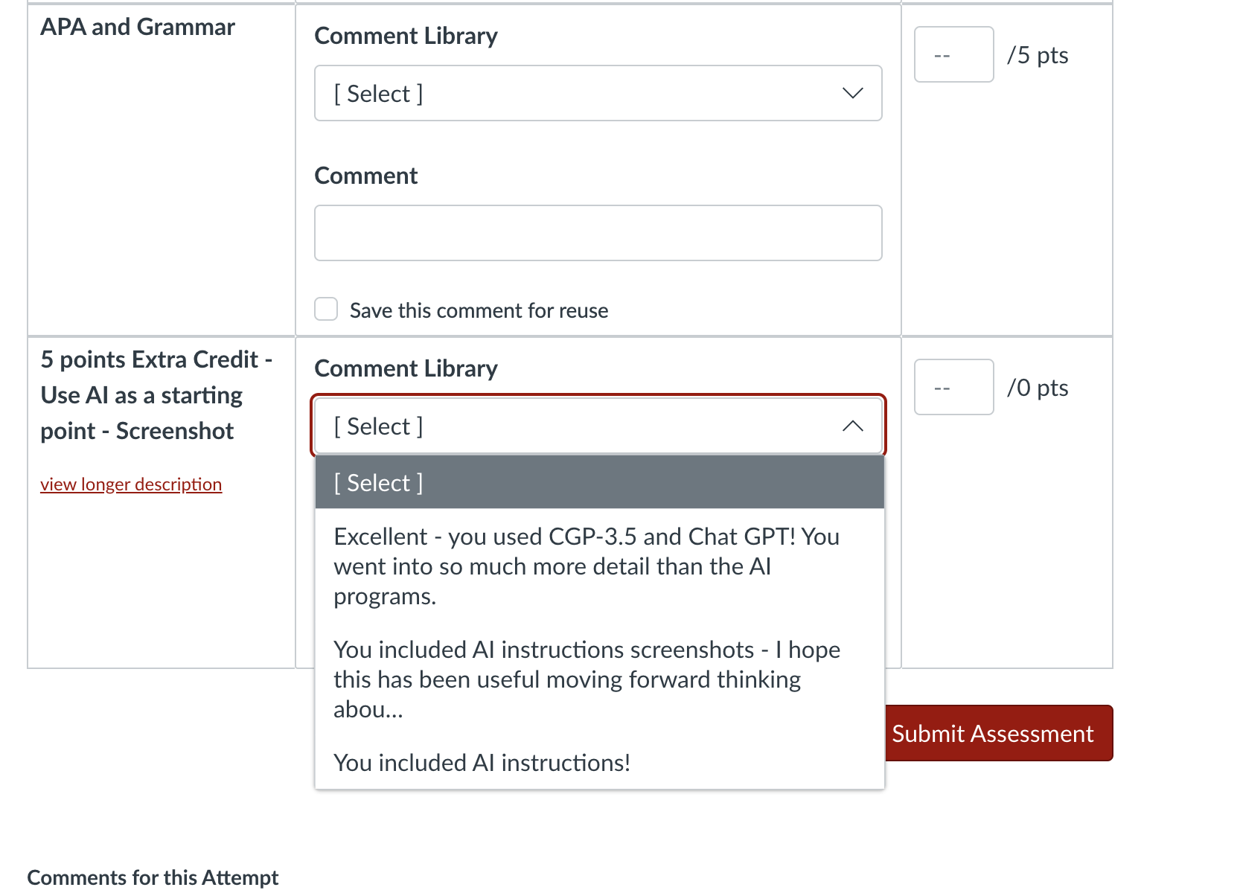
In Speedgrader – use written comments that can be edited and recycled

Slide 9
Examples from Course

Slide 10
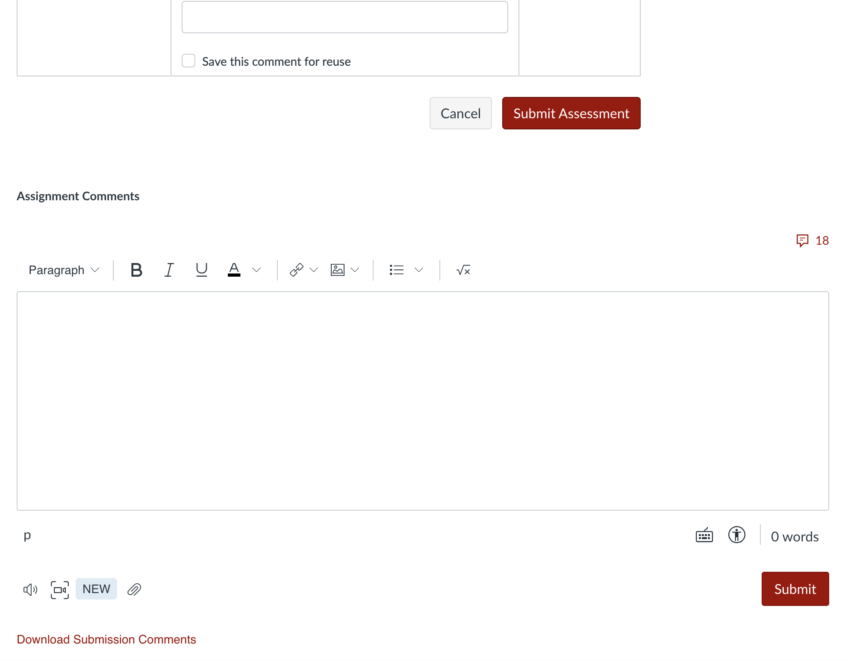
Canvas: Recycling Comments in the Comments Section
Audio and Video Feedback
Library of comments

Slide 11
Examples from Canvas Course

Slide 12
Useful Feedback 1) What learners did well 2) What learners can do to strengthen their assignment/submission 3) Challenges to extend thinking: what it? What next? What are you still curious about? 4) Challenges to application – what it this happened, then what?

Slide 13
Gradescope

Slide 14
Gradescope
University of Utah supported app

Slide 15
Gradescope: AI assisted grading

Slide 16
Grading Demo

Slide 17
Mobile App (think of F2F Class Use)

Slide 18
Gradescope Supported by Digital Learning Technologies classhelp@utah.edu

Slide 19
In Chat: What has surprised you? What is new to you? What do you want to hear more about?

Slide 20
Questions and Comments

